Slide 1
UNLV Foundation
Supporting UNLV’s mission of teaching, research, and public service

Slide 2
About UNLV Foundation
Mission
Board of Trustees
Development Team
Rebel Ring Phonation
Who and Where?

Slide 3
Mission
The University of Nevada, Las Vegas Foundation is a nonprofit organization that raises and manages private funds for the benefit of the University of Nevada, Las Vegas. These funds enhance the quality of the University and strengthen its missions of teaching, research, and public service.

Slide 4
Board of Trustees
60 member volunteer board
Leadership
Nancy Strouse, Executive Director
Mark L. Fine, Chairman
John O'Reilly, Esq. '74, Vice Chairman
Michael Yackira, Treasurer
Ex-Officio Trustee
Matt Engle '91 President UNLV Alumni Board of Directors

Slide 5
Development Team
Executive Director & Sr. Associate Vice President for Development
Development Officers
Donor Relations
Accounting
IT & Records
Research

Slide 6
Rebel Ring Phonathon
Student callers
48,000 calls
Over 65% increase in donors in two years
Goals
Connect with a student
Verify information
Ask for support

Slide 7
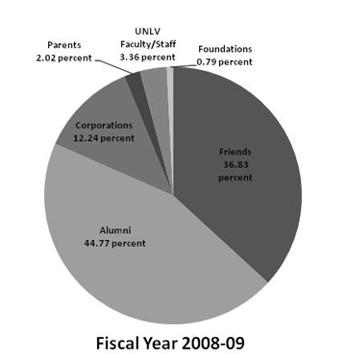
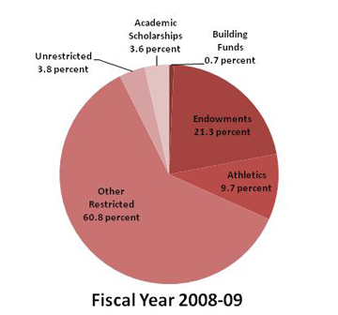
Who Gives and where does it go?

Slide 8
Thank you
Scott M. Roberts
Associate Vice President for Development
UNLV Foundation
Scott.roberts@unlv.edu
702-895-2816

